Slide 1

GameCo Marketing Analysis (2016-17)
Presented by : Alankar Dhumal-Data Analytics Team

Slide 2
Presentation Overview
Recommendations
The best platforms
STEP-5
The best Prospective Genres
STEP-4
The best Prospective Regions
STEP-3
Regional % Shares In Total Sales
STEP-2
Global Sales Trends Across All Regions
STEP-1

Slide 3
Geographic Regions of Data
NA Region
EU Region
JP Region
Other Region

Slide 4
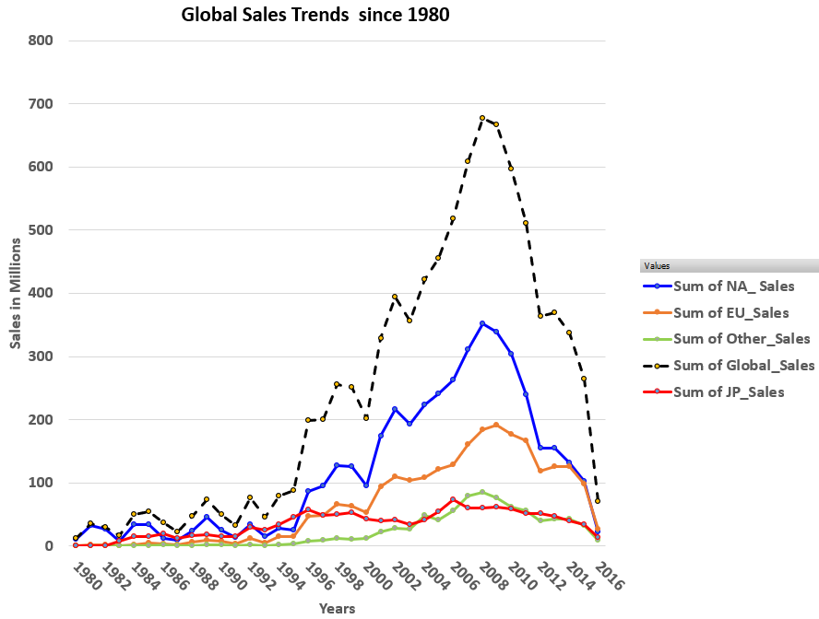


Global Sales Trends Across All Regions
Steep decline in sales

Slide 5

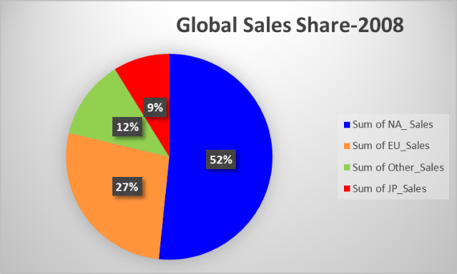
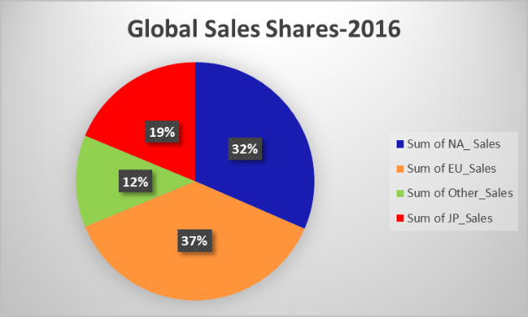
Regional % Shares In Total Sales
Contrary to GameCo’s assumption that the regional sales would be same over the time, the regional shares show a significant change
JP 10 % growth
EU 10 % growth
* Data analysed from the peak sales Year of 2008 till 2016

Slide 6



Regional % Shares In Total Sales
NA region share shrunk from 52% to 32%
NA region does not look like a region for future investments
JP and EU shares grew by 10% each.
These regions are more promising for investments

Slide 7
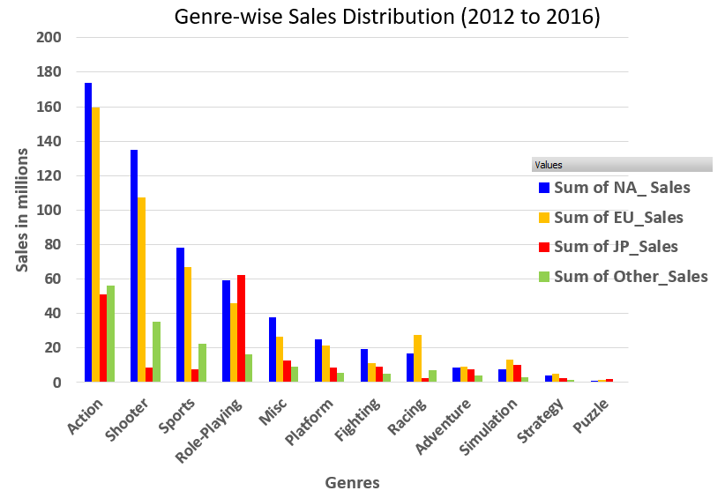
The Best Prospective Genres
Top-5 Genres
Action
Shooter
Sports
Role Playing
Misc
Role Playing is the highest selling Genre in JP
* Only the most recent 5 years Data analysed due to a very dynamic market

Slide 8

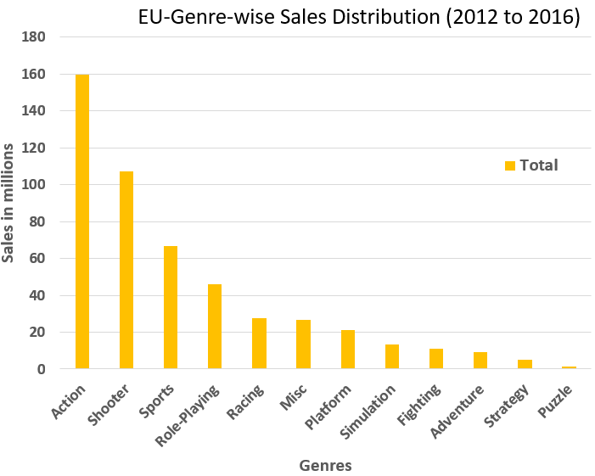
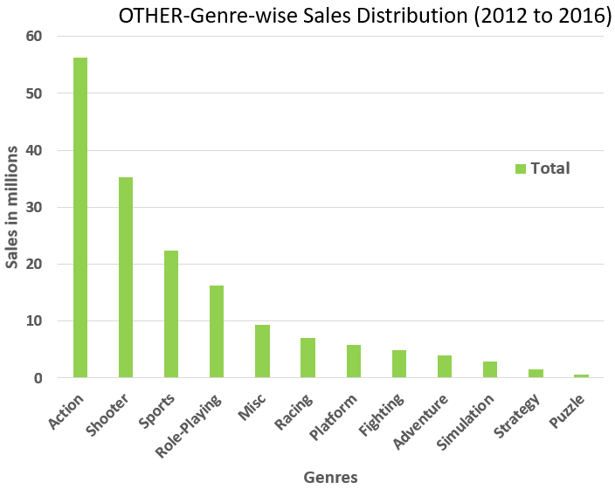
The Best Prospective Genres- EU & OTHER regions
EU & OTHER-Top-3 Genres
Action
Shooter
Sports

Slide 9
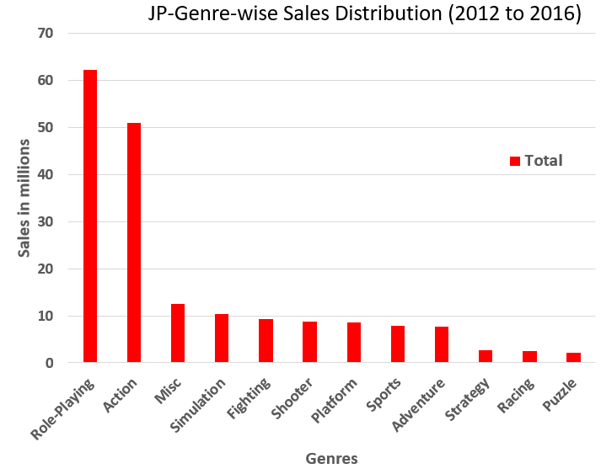
The Best Prospective Genres- JP regions
JP-Top-3 Genres
Role-Playing
Action
Misc

Slide 10
The Best Prospective Genres- JP regions
Best Genres to allocate resources in EU & OTHER region are “Action” & “Shooter”
Best Genres to allocate resources in JP region are “Role-playing” & “Action”

Slide 11
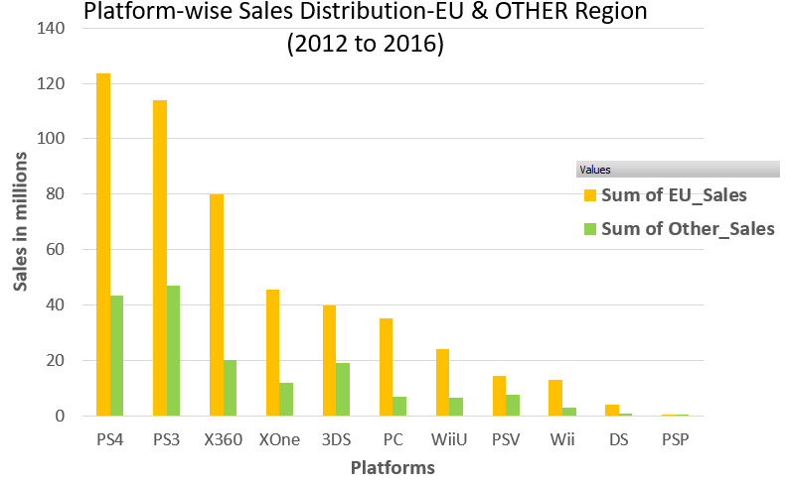
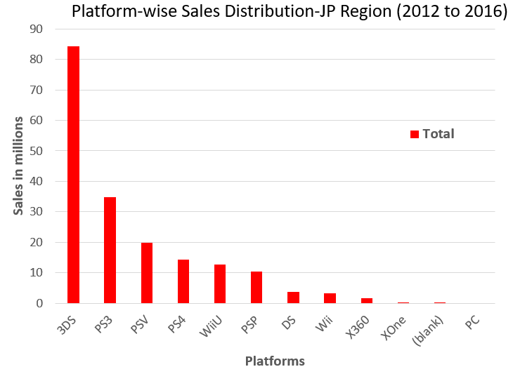
The Best Platforms
PS4 & PS3 Best Selling in EU & OTHER
3DS & PS3 Best Selling in JP
PS4 ,PS3 & 3DS is the best combination for platforms

Slide 12
Recommendations by Data Analytics Team
EU region :
Marketing resources to be allocated to PS4 & PS3 platform based “Action” & “Shooter” games
JP region :
Marketing resources to be allocated to 3DS & PS3 platform based “Role-playing” & “Action” games with special focus on 3DS based “Role-playing” games
OTHER region :
Marketing resources to be allocated to PS4 & PS3 platform based “Action” & “Shooter” games
NA Region :
No marketing budget to be allocated to NA region without fully analysing what has caused the steep decline in sales.

Slide 13

End

